Slide 1

Тема:«Бабушка и дедушка!»

Slide 2
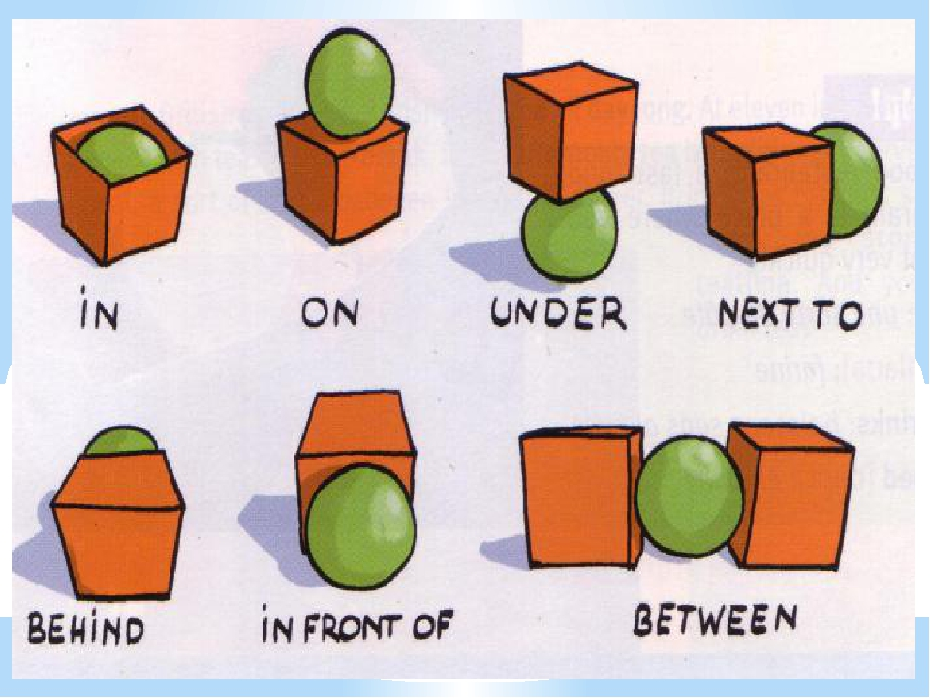

Slide 3
Предлоги места:
In – в
On- на
Under - под
Next to – рядом, близко
Behind – за, позади
In front of – перед
Between - между
For example:
On the box – на коробке
Under the box – под коробкой
Behind a box – за коробкой
Next to box – рядом с коробкой
In the box – в коробке
In front of box – перед коробкой
Between boxes – между коробками

Slide 4
Ex. 1 p. 92
Keys: 1) in 2)in front of 3) behind
4) Next to 5) on 6) under

Slide 5
Ex. 2 p. 92
Answer the questions:
Where's Larry?
Where's Lulu?
Where's the ball?
Where's grandpa?
Where's Chuckles?
Where's the food?

Slide 6
Ex. 4 p.93
/u:/ /ᴧ/
Lulu under
Ruler puppet
Blue number
Music sun
Computer

Slide 7
Thank you for the attention!

