Slide 1
family tree проект
Выполнила: ученица 6 класса Лукашова Ольга.

Slide 2
Цель проекта: Больше узнать о своей семье; Составить семейное древо.
Задачи:
Изучить свою родословную:
а) по воспоминаниям родственников
б) по документам семейного фотоархива
2) Составить генеалогическое древо моей семьи.

Slide 3
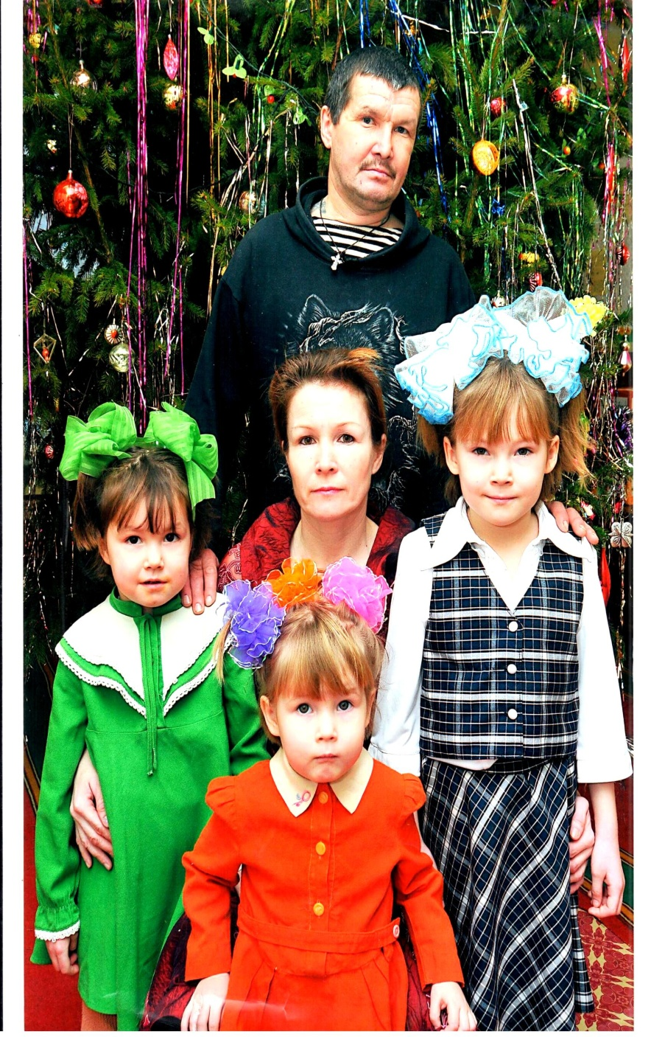
My names Olga . I am 13 years old and Id like to tell you about my family. My family is large and very friendly .I have mother, father, two sisters, and brother.
My father name is Lukashov Viktor Nikolaevich He is kind and clever person. He was born in the village Otary in 1963. My mother is name is Lukashova Nina Yurevna. She is a house wife .She was born in the village Arda in 1969. She is very beautiful and kind. My olden sisters name is Karina. She is 15.She is a student. My little sisters name is Luba . She is 11. They are active and funny girls. I have a brother too. His name is Denis.

Slide 4
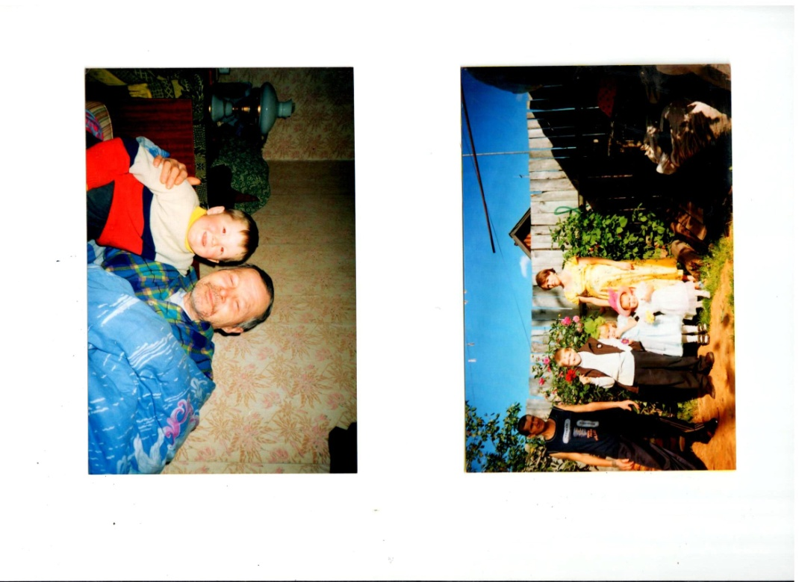
. My olden sisters name is Karina. She is 15.She is a student. My little sisters name is Luba . She is 11. They are active and funny girls. I have a brother too. His name is Denis.
He is 21 . He is study in St Petersburg. He will be a seaman.
Un fortunately we haven’t got grandparents alive. They died at last but we remember them.
My grandparents name is :Romanova Zoya Ivanovna, Lukashova Valentina Alekseevna, Romanov Yuriy Evseevich, Lukashov Nikolay Stepanovich.

Slide 5
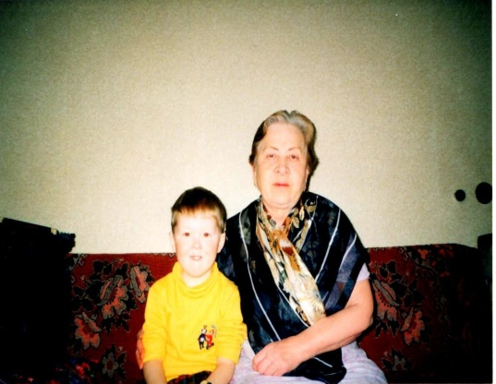
Un fortunately we haven’t got grandparents alive. They died at last but we remember them.
My grandparents name is :Romanova Zoya Ivanovna, Lukashova Valentina Alekseevna, Romanov Yuriy Evseevich, Lukashov Nikolay Stepanovich.

Slide 6
My FAMALY TREE
grand-grandma Lukashova Anna Kuz’minichna
1908-1995
grand-grandpa Lukashov Stepan Fyodorovich
1908-1942
grand- grandma Smirnova Praskov’ya
grand-grandpa Smirnov Ivan Grigor’evich
grandpa Romanov Yuriy Evseevich
1939-2015
Grandma Romanova Zoya Ivanova
1938-2003
grandpa Lukashov Nicolay Stepanovich
1932-2002
grandma Lukashova Valentina Alekseevna
1935-1996
Aunt Perova Galina Nikolaevna
1960
aunt Vorob’yova Lyudmila Nikolaevna
1958
Father Lukashov Viktor Nikolaevich
1962
Mather Lukashova Nina Yur’evna
1969g
aunt Pushkina Sveta Yur’evna
1965
uncle Romanov Sergey Yur’evich
1964
Sister Lukashova Karina Viktorovna 2003
sister Lukashova Luba Viktorovna 2006
brother Lukashov Denis Viktorovich 1997
Lukashova Olga Viktorovna 2005

Slide 7
The motto of my family
We live, love our keeping, we can do everything because we are family.
Живём, любовь свою храня мы сможем всё ведь мы семья.

Slide 8
Список использованных источников
1 Фотоархив семьи
2 Воспоминания родителей

Slide 9
Thank you for attention!

