Slide 1
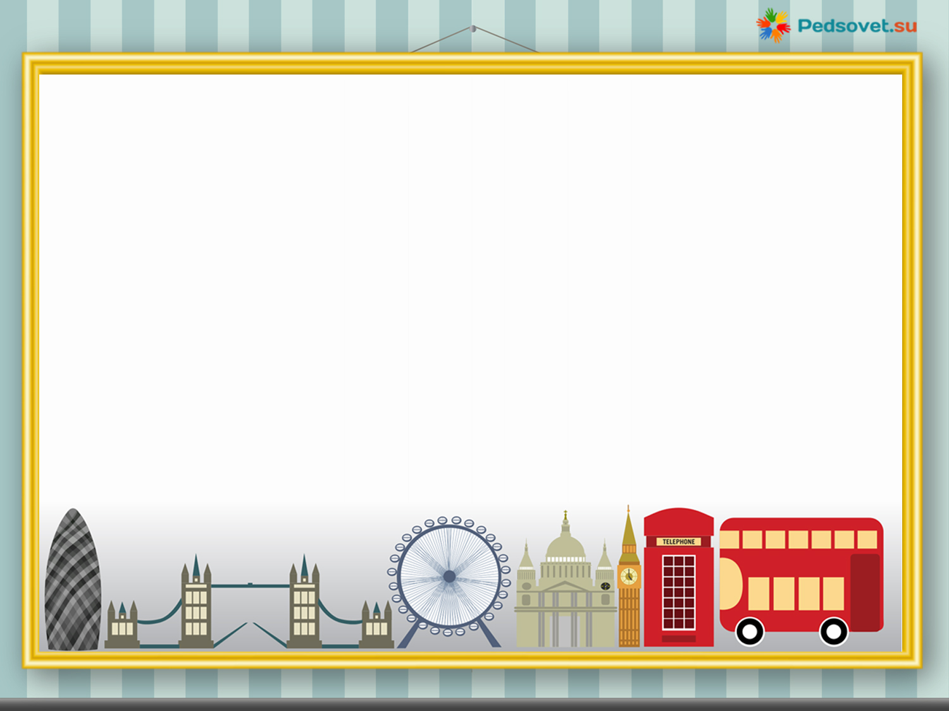
Enjoy
English
Ивлева Светлана Евгеньевна
учитель английского языка и истории
МБОУ Емешевская СОШ
Республики Марий Эл

Slide 2

You will hear a story. For questions 1-7 complete the missing information. You will need to write a number, a word or several words. You will hear the story twice.
My weekdays.
1. How many children does the woman have? (1)_____
2. When do her children get up? (2)_____
3. Where does she go early in the morning? (3)_____
4. What does she do on Mondays? (4)_____
5. Who likes cook in their family? (5)_____
6. How often does she visit her father? (6)_____
7. How often do they visit their friends? (7)_____

Slide 3
1. - two children
2. - at seven o’clock
3. – to the gym
4. – goes shopping
5. – her husband
6. – twice a week
7. – sometimes

Slide 4
2. You will hear a story. Сomplete the missing information. You will hear the story twice.
Not long ago some shoppers were asked to test … packets of coffee. They were given the coffee to … . It came from four packets. Each packet was a … colour; brown, red, blue, or yellow. 8 people out … every 10 said the coffee in the brown packet … too strong. They said the red packet was « richer». … also said the blue packet of coffee was « milder». 9 … out of 10 said the coffee in the yellow … was «too weak». The funny thing was that the … had put exactly the same coffee in all four …!

Slide 5
Not long ago some shoppers were asked to test some packets of coffee. They were given the coffee to drink . It came from four packets. Each packet was a different colour; brown, red, blue, or yellow. 8 people out of every 10 said the coffee in the brown packet was too strong. They said the red packet was « richer». They also said the blue packet of coffee was « milder». 9 people out of 10 said the coffee in the yellow pack was «too weak». The funny thing was that the testers had put exactly the same coffee in all four packets!

Slide 6
Good Food for Good Life
We need good food for good life. Good food has a lot of vitamins, proteins (белки) and minerals. They are in vegetables, fruits, bread, milk, meat, fish and porridge. These things help to make your bones and teeth strong. They make your body strong and healthy.
It's important to eat enough - not too much and not too little. Too much food makes you fat. Too little food makes you weak.
Are these statements true (T) or false (F)?
1. We need bad food for good life.
2. We need few vitamins.
3. It's important to eat much.
4. Minerals make your bones and teeth strong.
5. Vitamins, proteins, minerals make you healthy.

Slide 7

Look at the window, look at the door,
Look at the chair, look at the floor,
Look at the blackboard,
Look at the lamp.
Look at the table, this is the end.
I look at the window, I open the door,
I sit on the chair. I jump on the floor.
I go to the blackboard,
I look at the lamp, I sit at the table
And this is the end.

Slide 8
3. Read the text.
bring – brought- привозить grow – grew - выращивать, расти
expensive - дорогой сheap – дешевый
Food from around the world
We eat a lot of different kinds of food today. Before the 16th century, people in Europe didn't have
a lot of things that we can eat and drink every day.
At the end of the 15th century, people from Europe started to travel to other parts of the world. They went to America, Africa and Asia. They brought back a lot of new kinds of food.
Chocolate came from Mexico. The Aztecs there drank chocolate with pepper! The Spanish brought chocolate to Europe and they were first to put sugar in it. Until the 1870s, chocolate was only a drink. The Swiss made the first bar of chocolate in 1876.
Tomatoes, peppers and avocados all came from Mexico, too. The Spanish took seeds back to Spain and started to grow the plants there. Soon they spread to other countries in Europe and then to other parts of the world. The words tomato, chocolate and avocado all come from the old Aztec language.
Potatoes came from South America. Potatoes like cold, wet weather. They grew in the mountains of Peru. Coffee came from Africa. The Turks took it to Turkey and then to Europe. Tea came from China in the 17th century. At first it was very expensive and only rich people drank it, but in the 19 th century the British started to grow tea in India. They produced a lot, so it was cheap and everybody could drink it.

Slide 9
Choose the correct answer:
1. People made the first bar of chocolate in
Britain
Switzerland
Spain
2. Europeans brought …………… from Mexico
peppers, tomatoes, chocolate and avocados
peppers, potatoes, chocolate and avocados
peppers, tea, chocolate and avocados
3. The British started to grow tea in…………
China
Turkey
India.
4. Coffee came to Turkey from………
Europe
Africa
India.
5. At first only rich people drank tea, because………
a) it was not very good
b) it was cheap
c) it was expensive
II. Answer the questions.
1. What did people bring back from America, Africa and Asia?
2. Who was the first to put sugar into chocolate?
3. Where did potatoes come from?
4. Did the Turks take coffee to Europe?
5. The Aztecs there drank chocolate with milk, didn't they?

Slide 10
4. Read the text and fill in the gaps transforming capitalized words.
At the Painting Club There are a lot of_________ there now. Sam is taking pictures of some___________ with his new digital camera. Sam’s father ____________a painter and __________ in the club. He teaches children how to paint. Betty is talking to her friend about their new teacher. Jenny is busy. She ____________a dinosaur. Peter is sitting next to___________. He is reading a book about a famous painter. Mr. White, Sam’s father, is showing some children his pictures. They ________ ready to begin a lesson. | CHILD PAINT BE WORK PAINT SHE BE

Slide 11
At the Painting Club
There are a lot of children there now. Sam is taking pictures of some paintings with his new digital camera. Sam’s father is a painter and works in the club. He teaches children how to paint. Betty is talking to her friend about their new teacher. Jenny is busy. She is painting a dinosaur. Peter is sitting next to her. He is reading a book about a famous painter. Mr. White, Sam’s father, is showing some children his pictures. They are ready to begin a lesson.

Slide 12
Complete the sentences. Choose the right variant.
1. This famous sportsman ………….. world records every year!
a) broke b) breaks c)broken
2. Listen! The sisters ………… that beautiful song again!
a)sang b)will sing c)are singing
3. My little brother always ……………… to sleep on time when he was a school boy.
a) went b)goes c) will go
4. ……. you already ……..this book by R. Kipling?
a) Are ……reading b) Have ….. read c)Did …… read
5. ……….. you take part in school competition next week?
a) Are b) Do c)Will

Slide 13
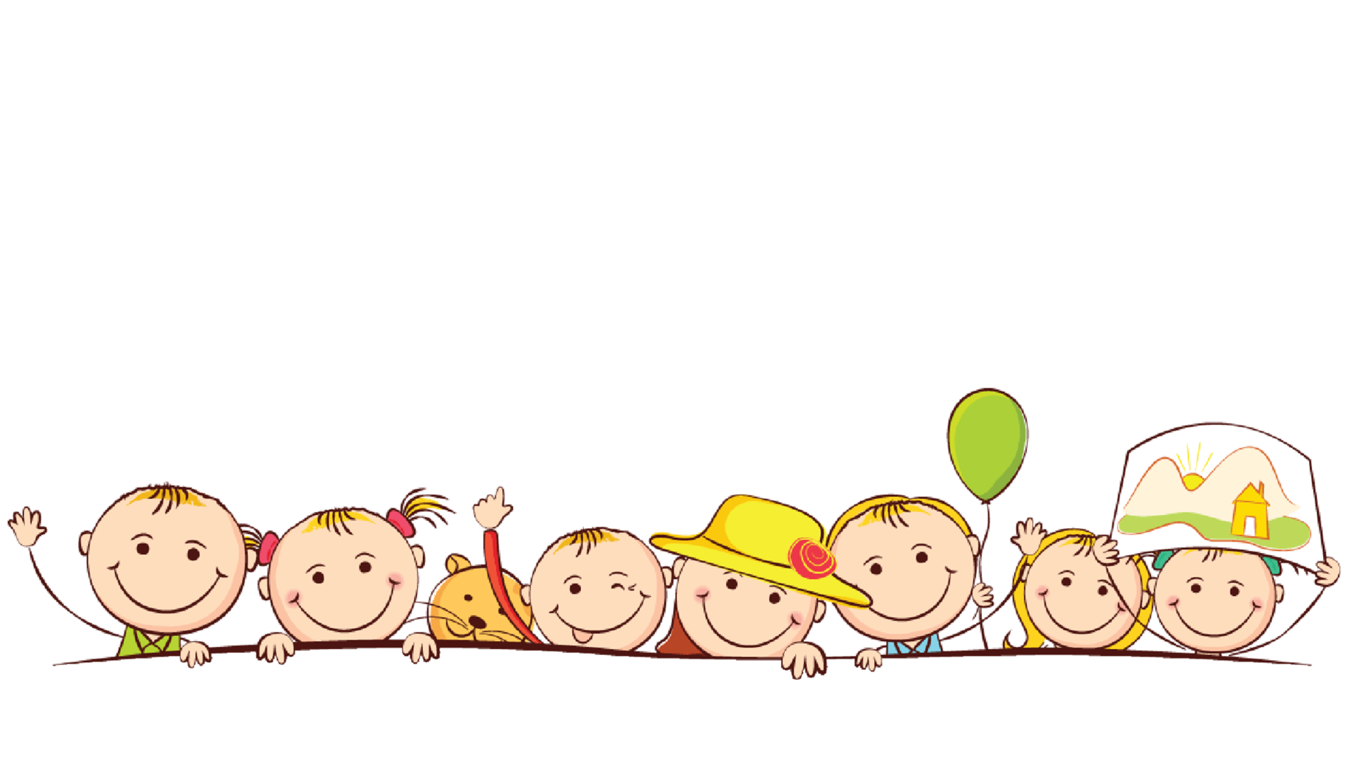
Thank you!

